Slide 1


Tales from the frontier

Slide 2
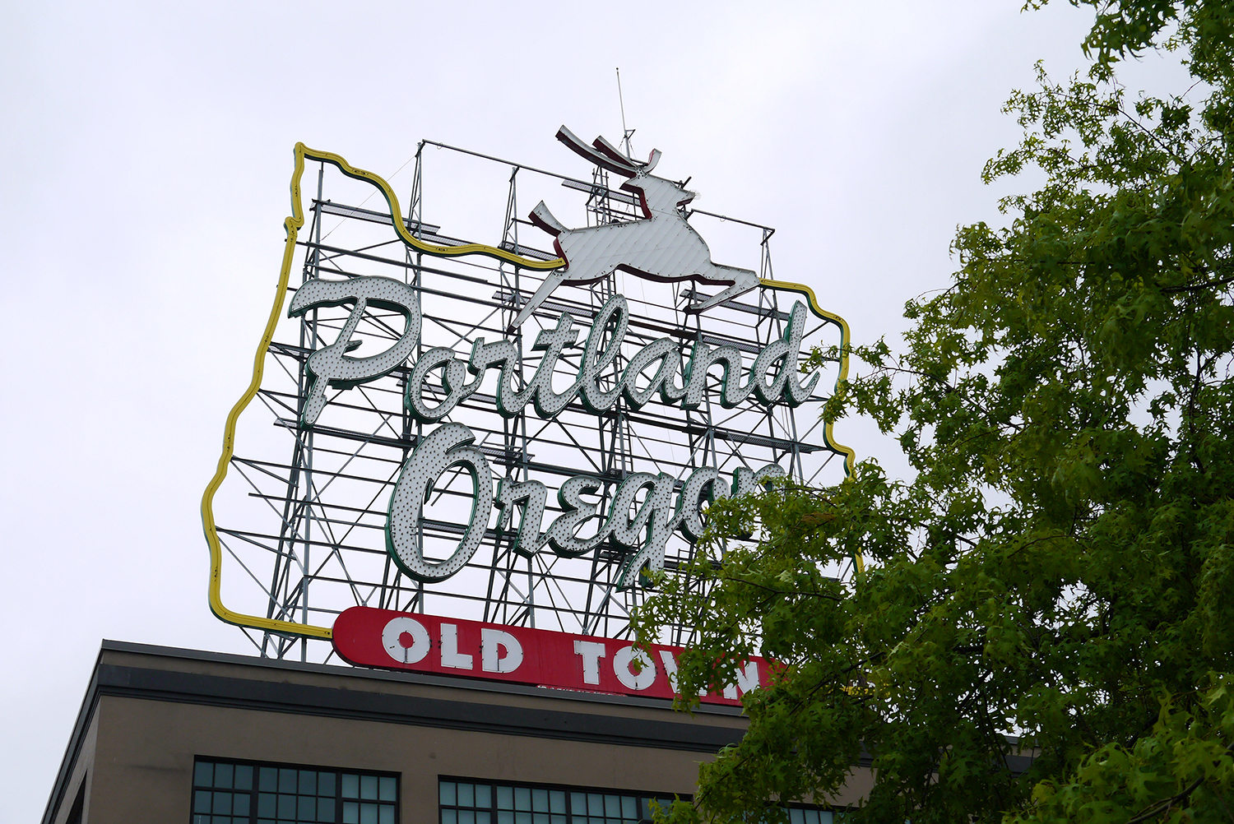
Portland
2nd city to pass an open data policy (2009- res 36735)
Open source bona fides
Super-collaborative dev community
3+ CfA Fellows
Code for Portland

Slide 3
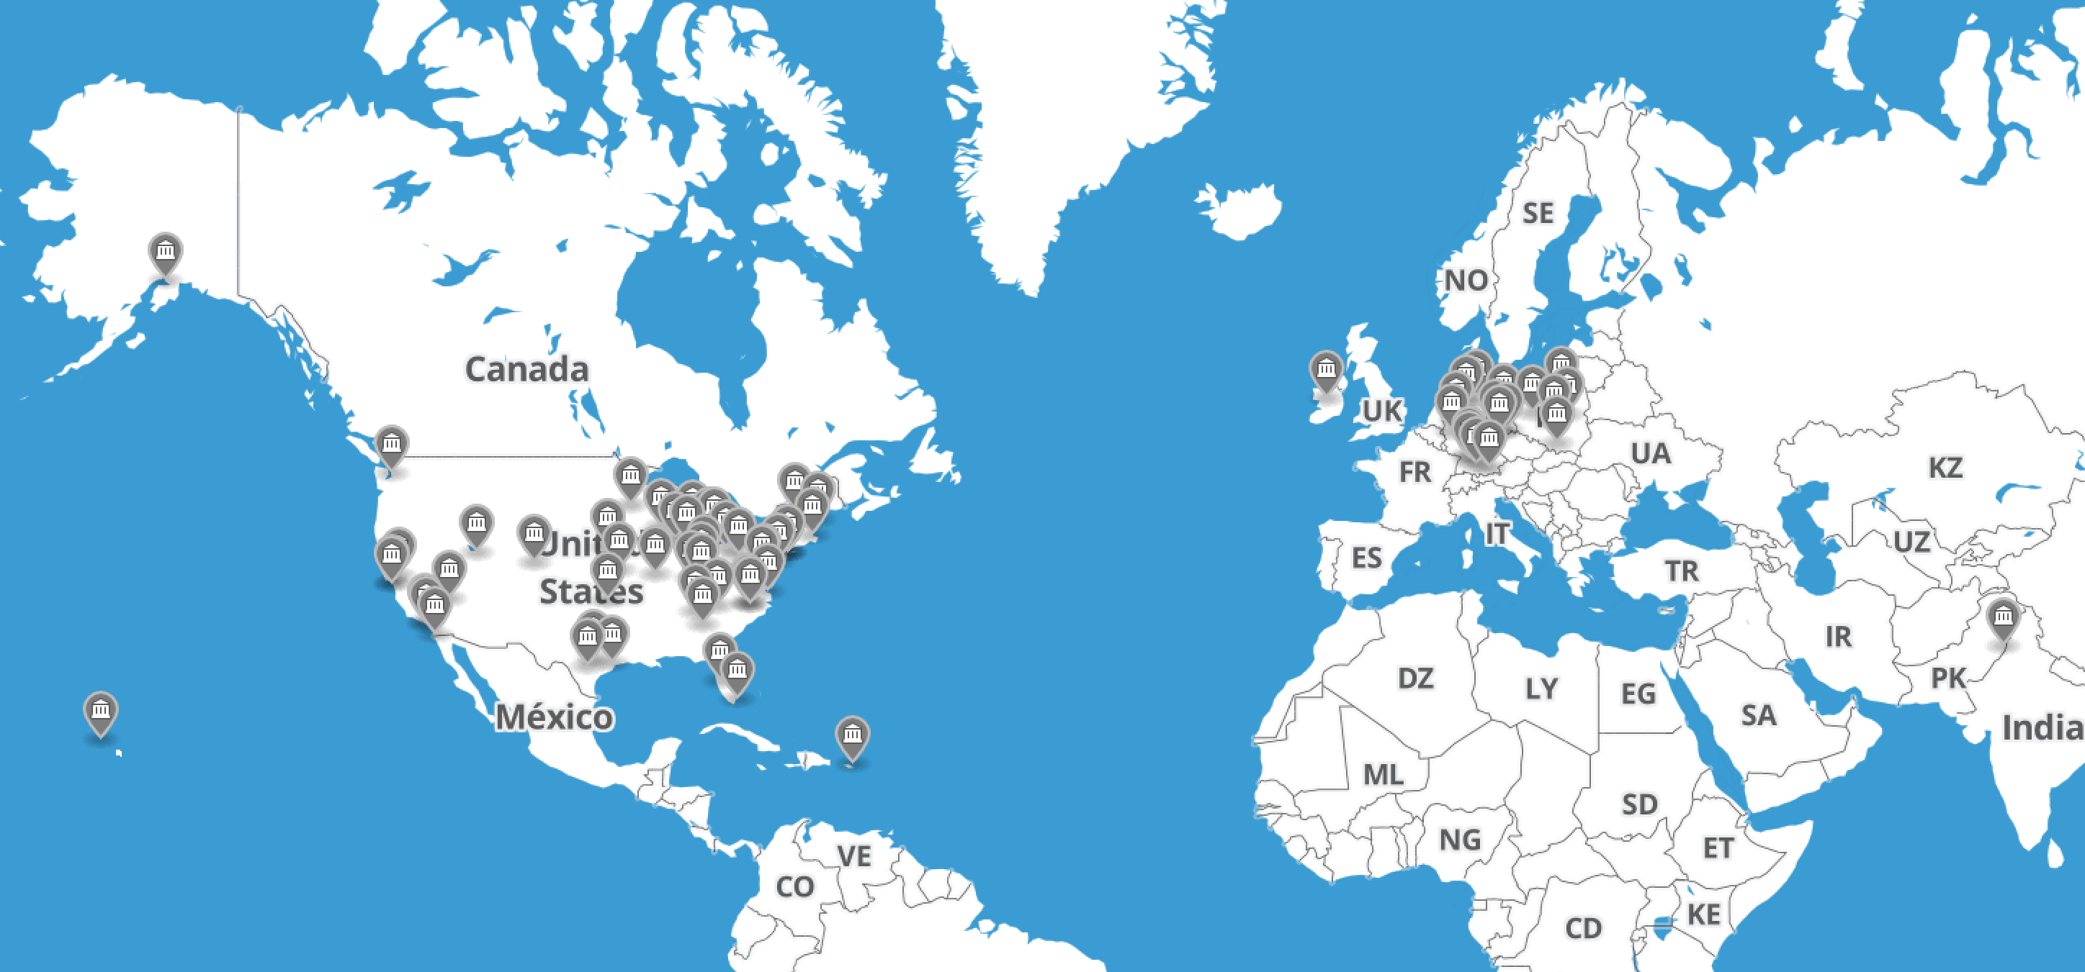
Code for All

Slide 4
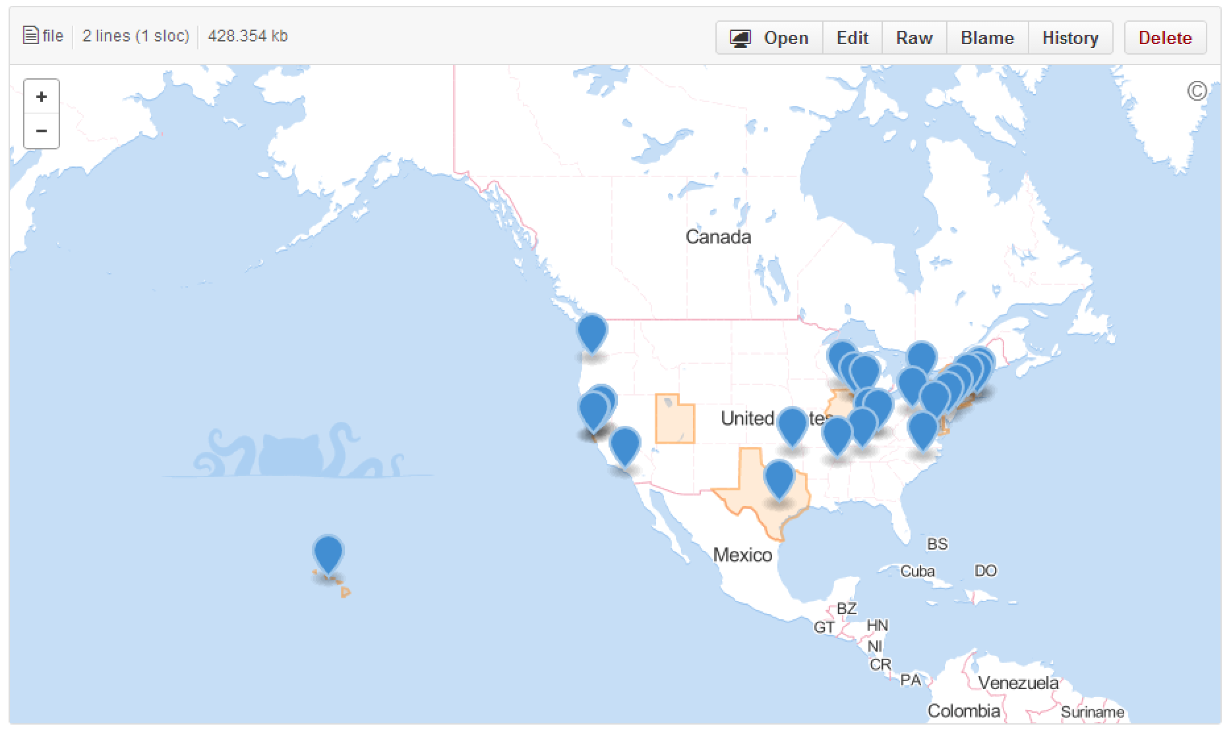
Open Data Policy

Slide 5
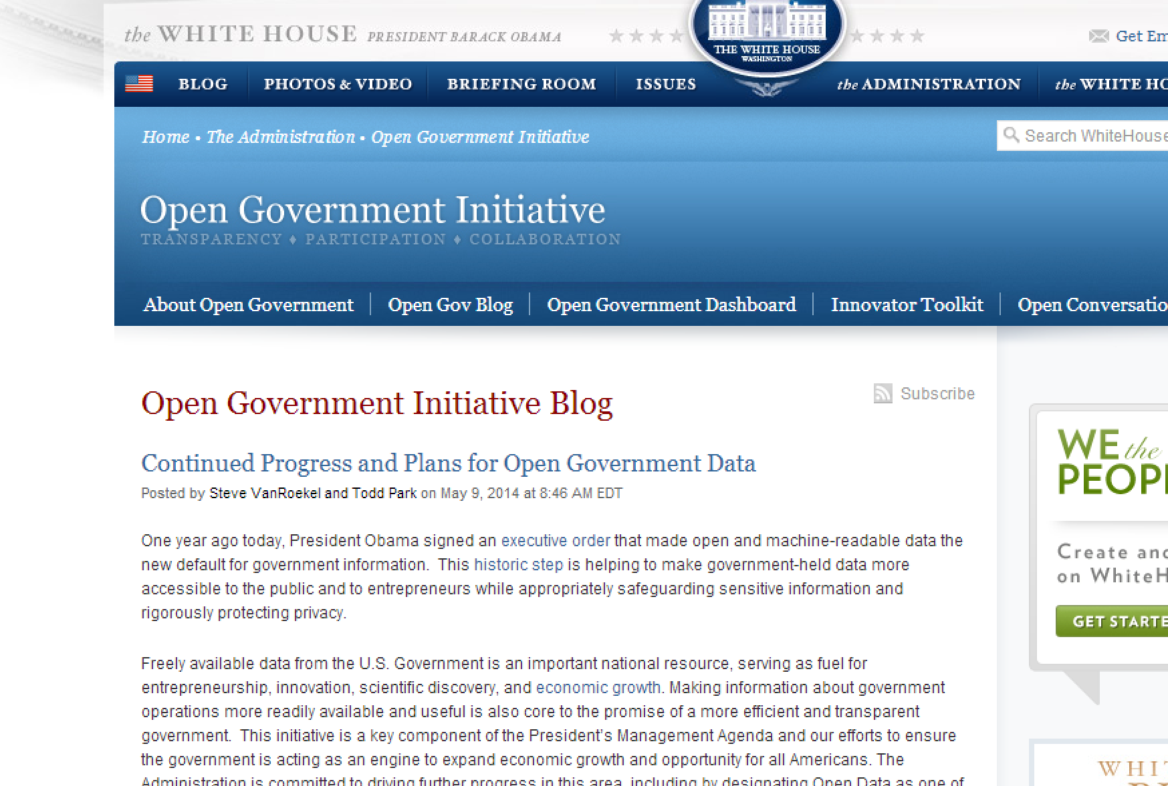
Notes:
Today, the white house announced a new open data action plan, including support for CC-0 public domain dedication for government data

Slide 6
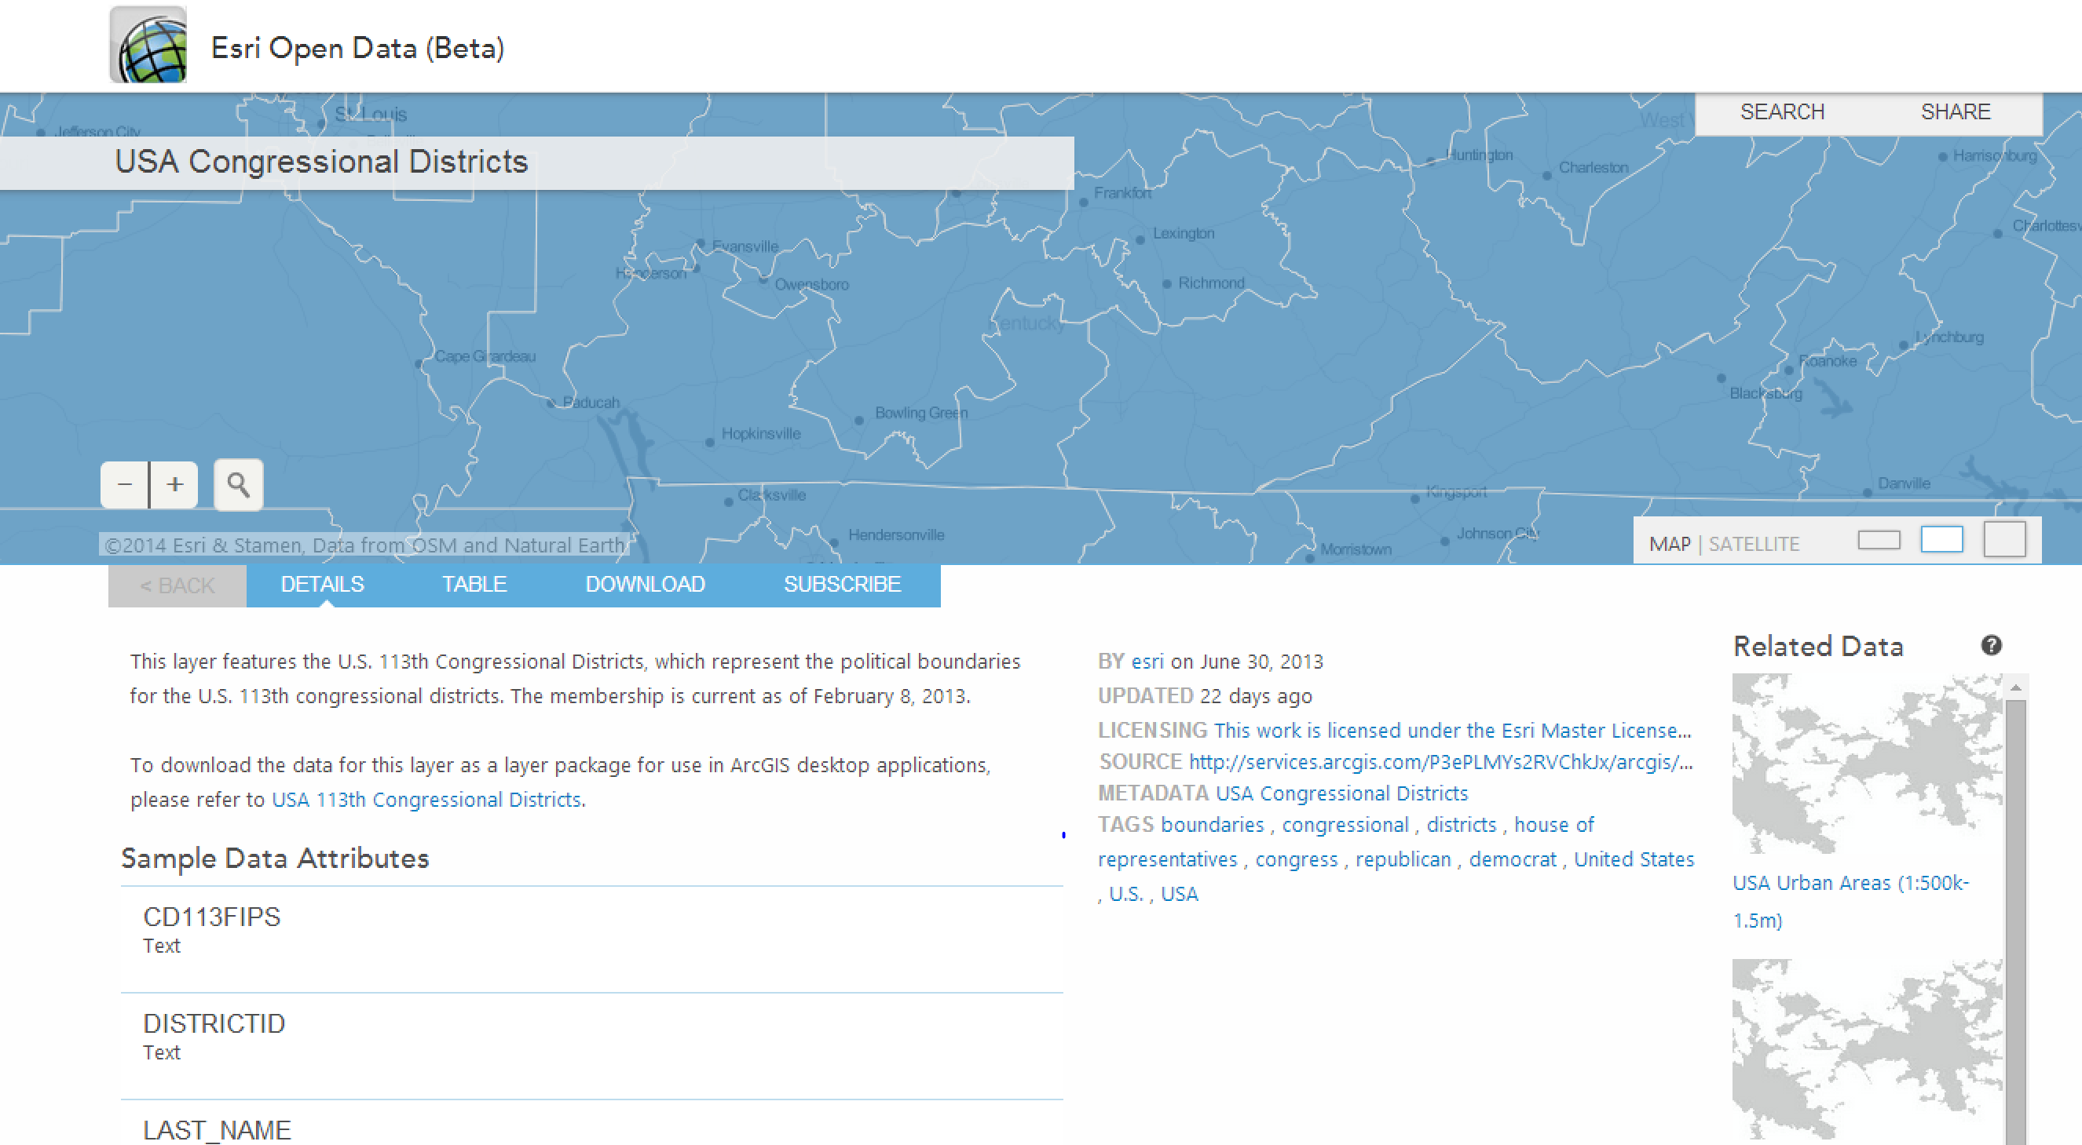
ArcGIS
Notes:
Vendors taking it seriously: arcgis

Slide 7
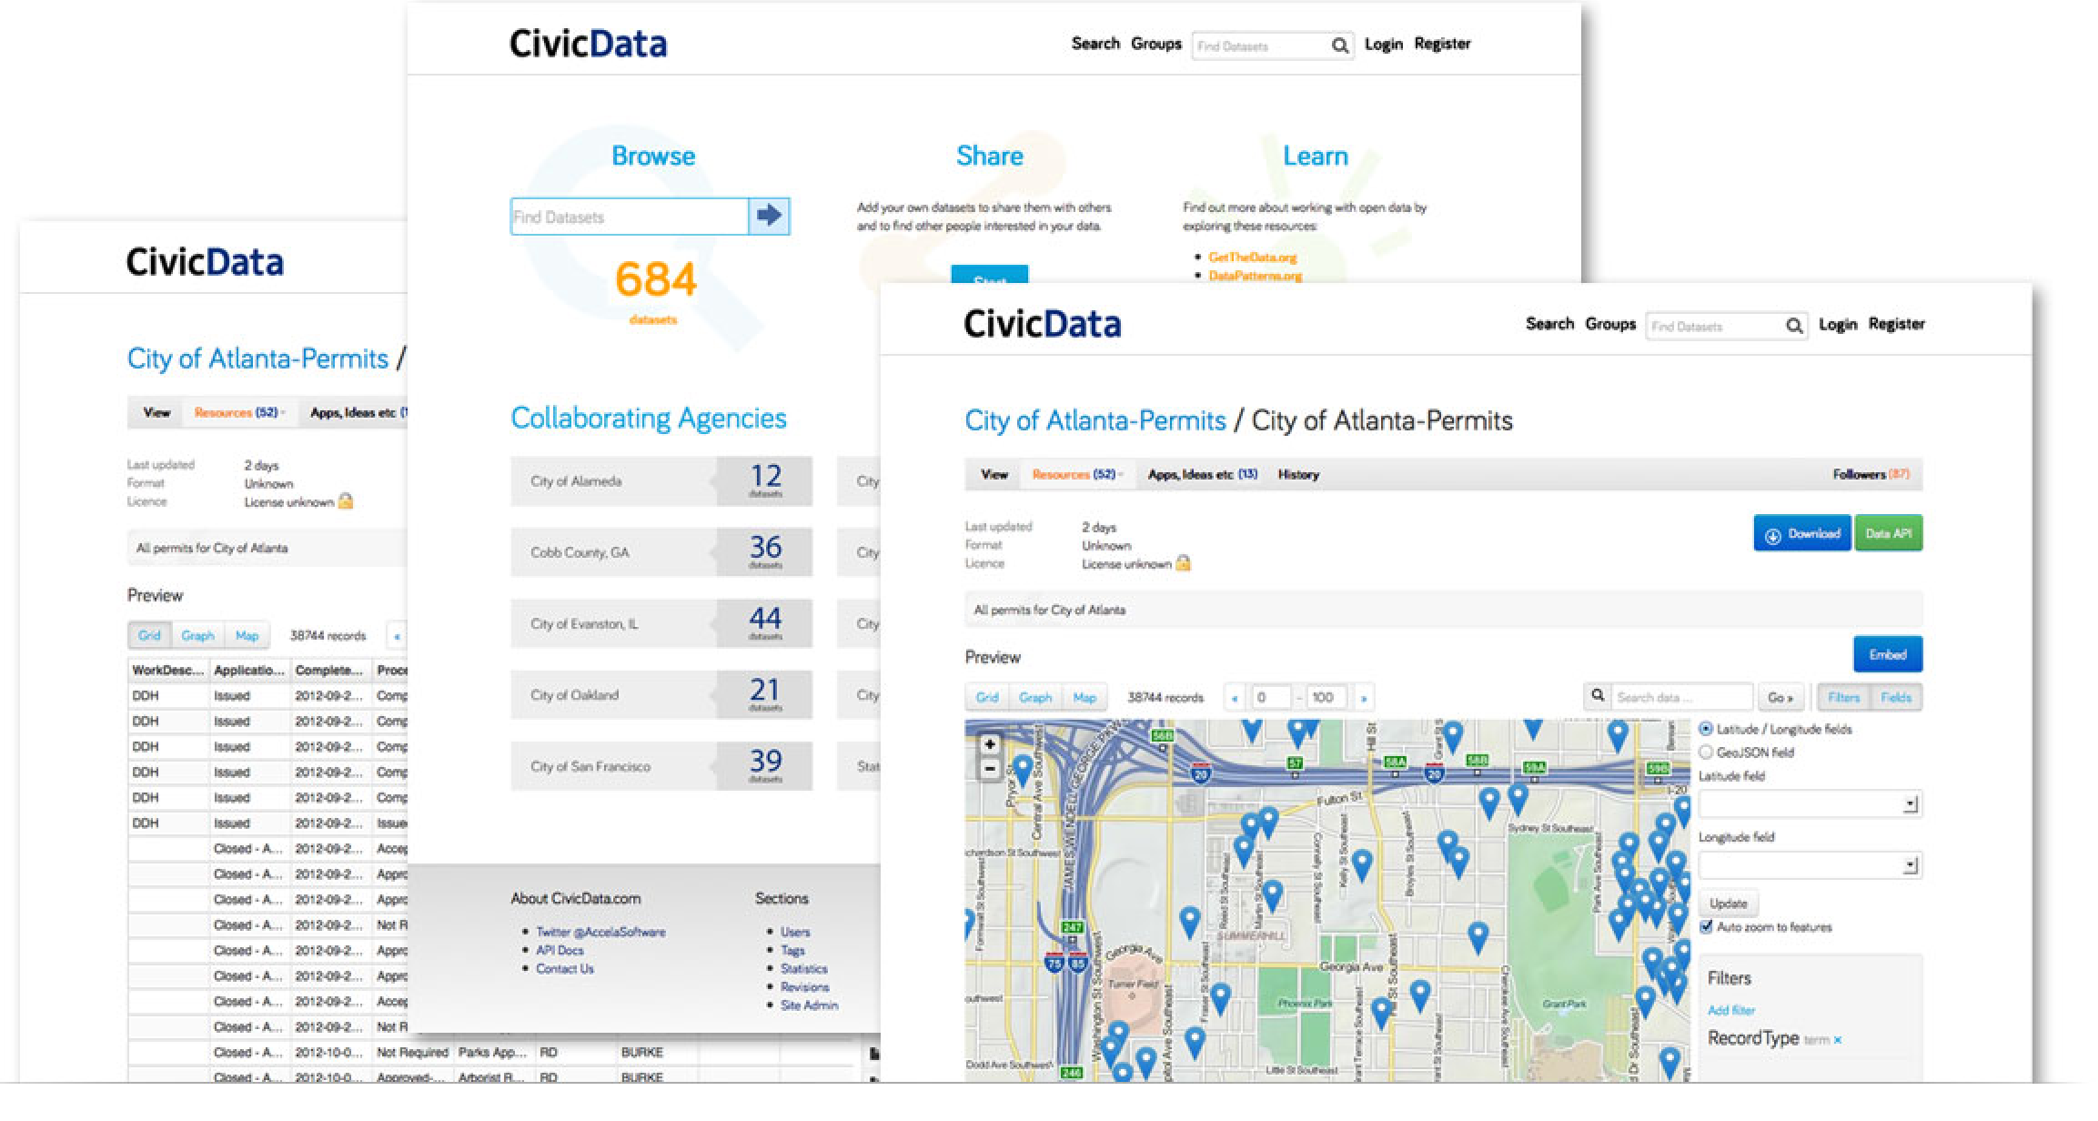
Accela
Notes:
accela

Slide 8
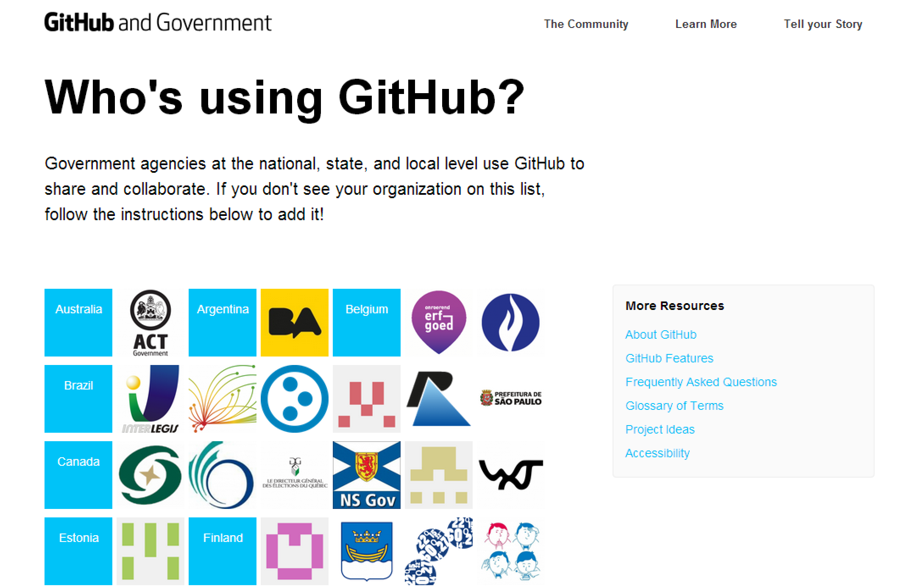
Notes:
github

Slide 9
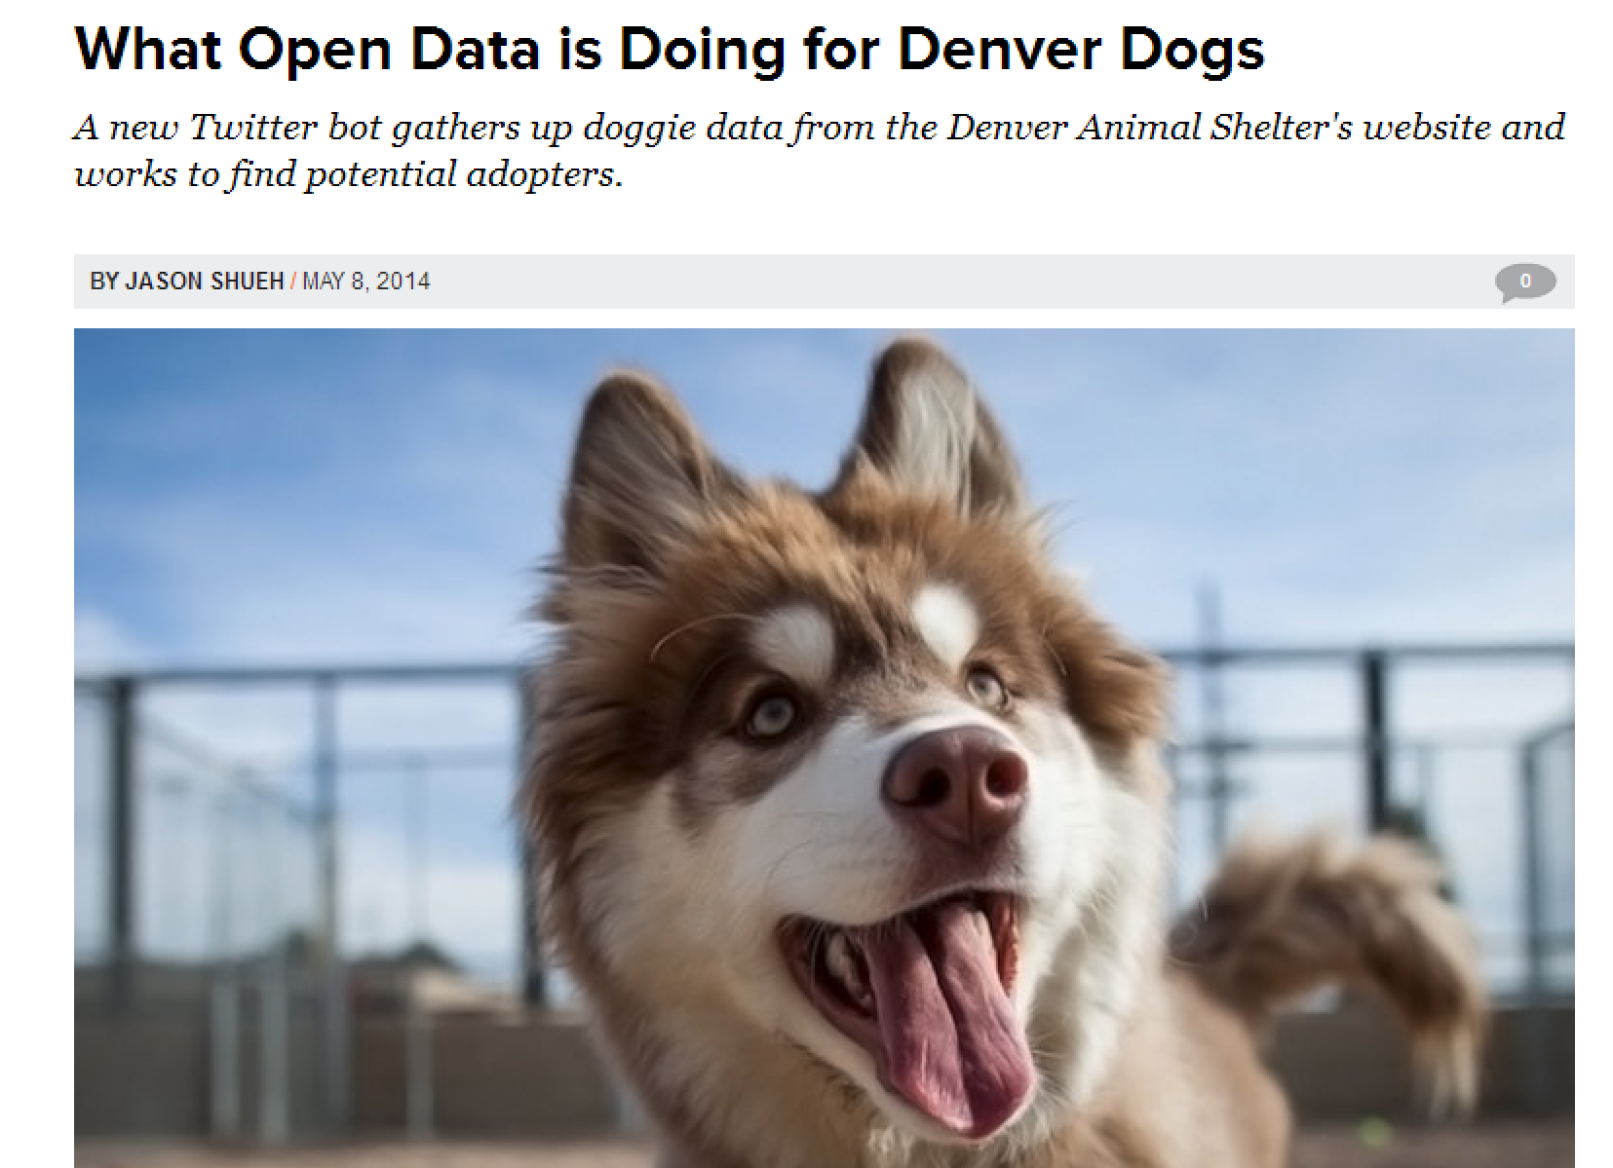
Notes:
Cuties in Denver

Slide 10
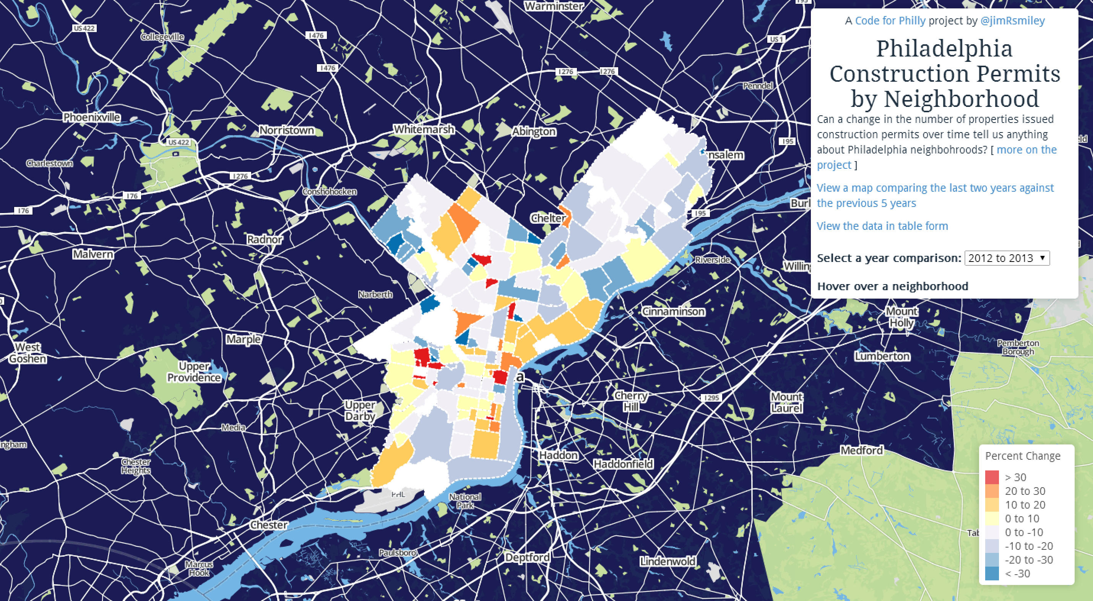
http://constructionpermits.phl.io/
Notes:
Philly: mapping construction boom

Slide 11
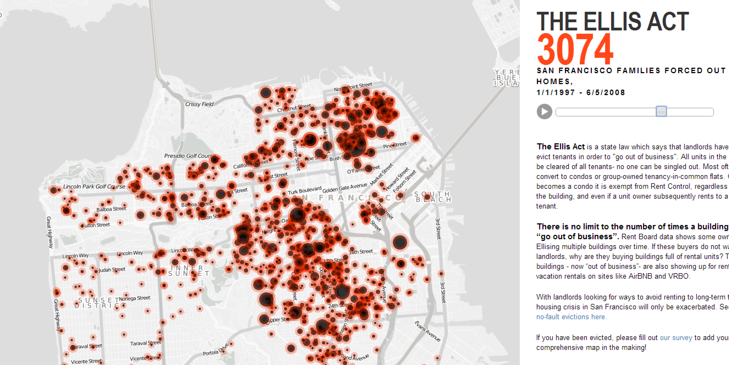
Notes:
SF anti eviction mapping project

Slide 12
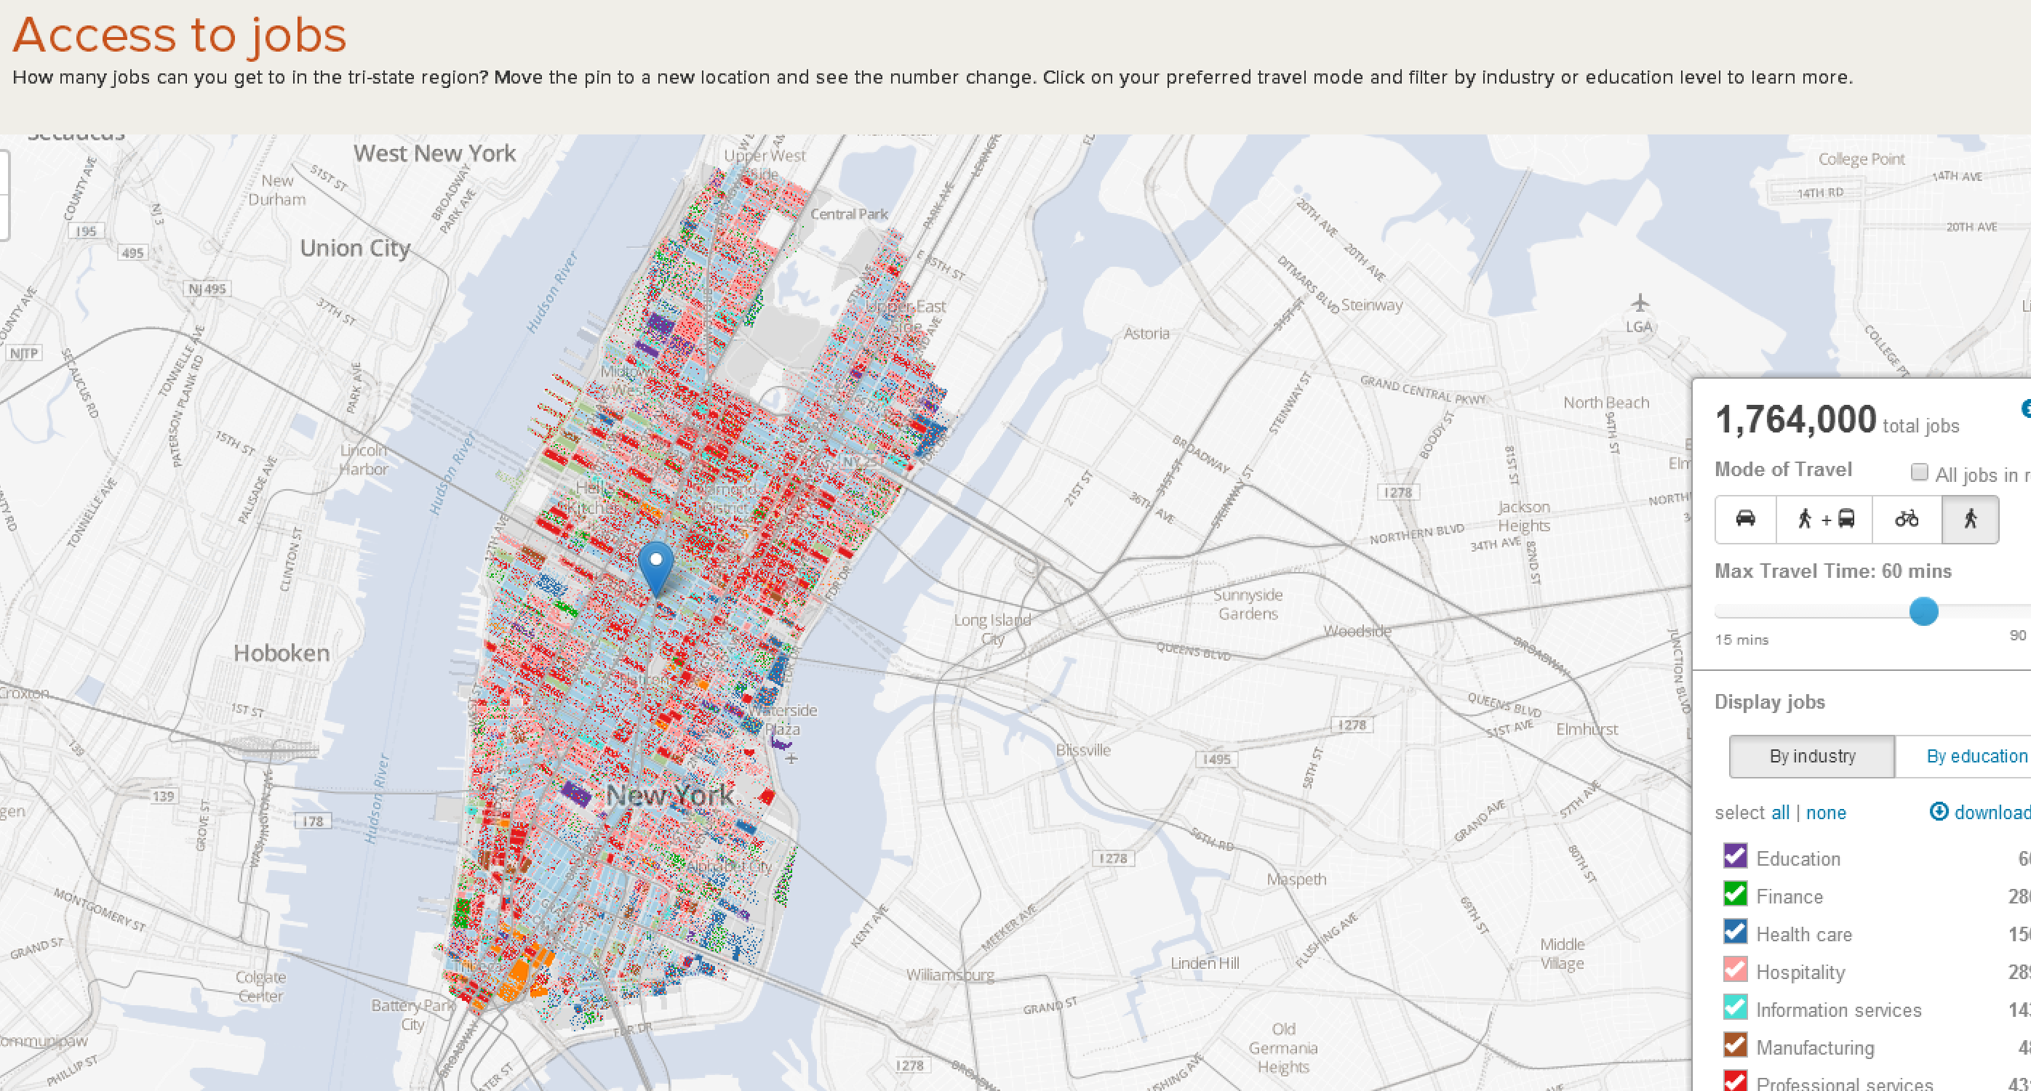
Notes:
Access to jobs by commute options in NYC

Slide 13
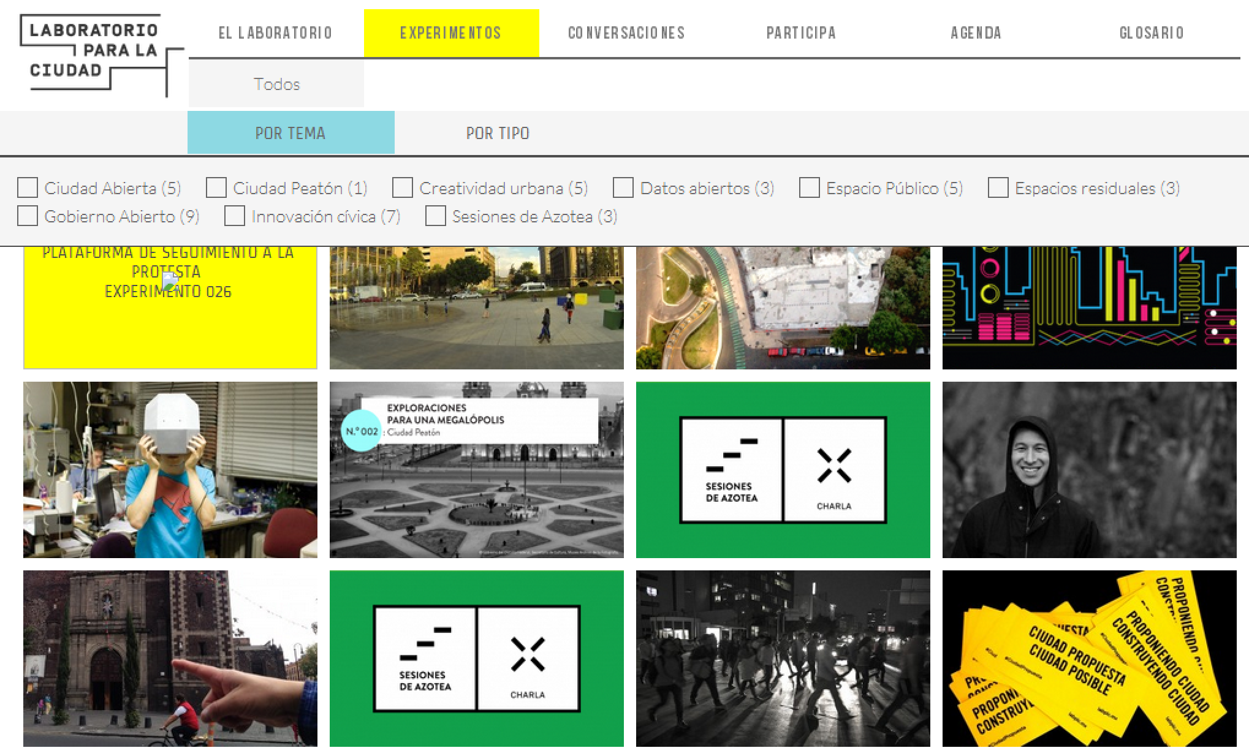
Notes:
Labplc – explicitly experimental, prolific: combining open data/tech & urban theory

Slide 14
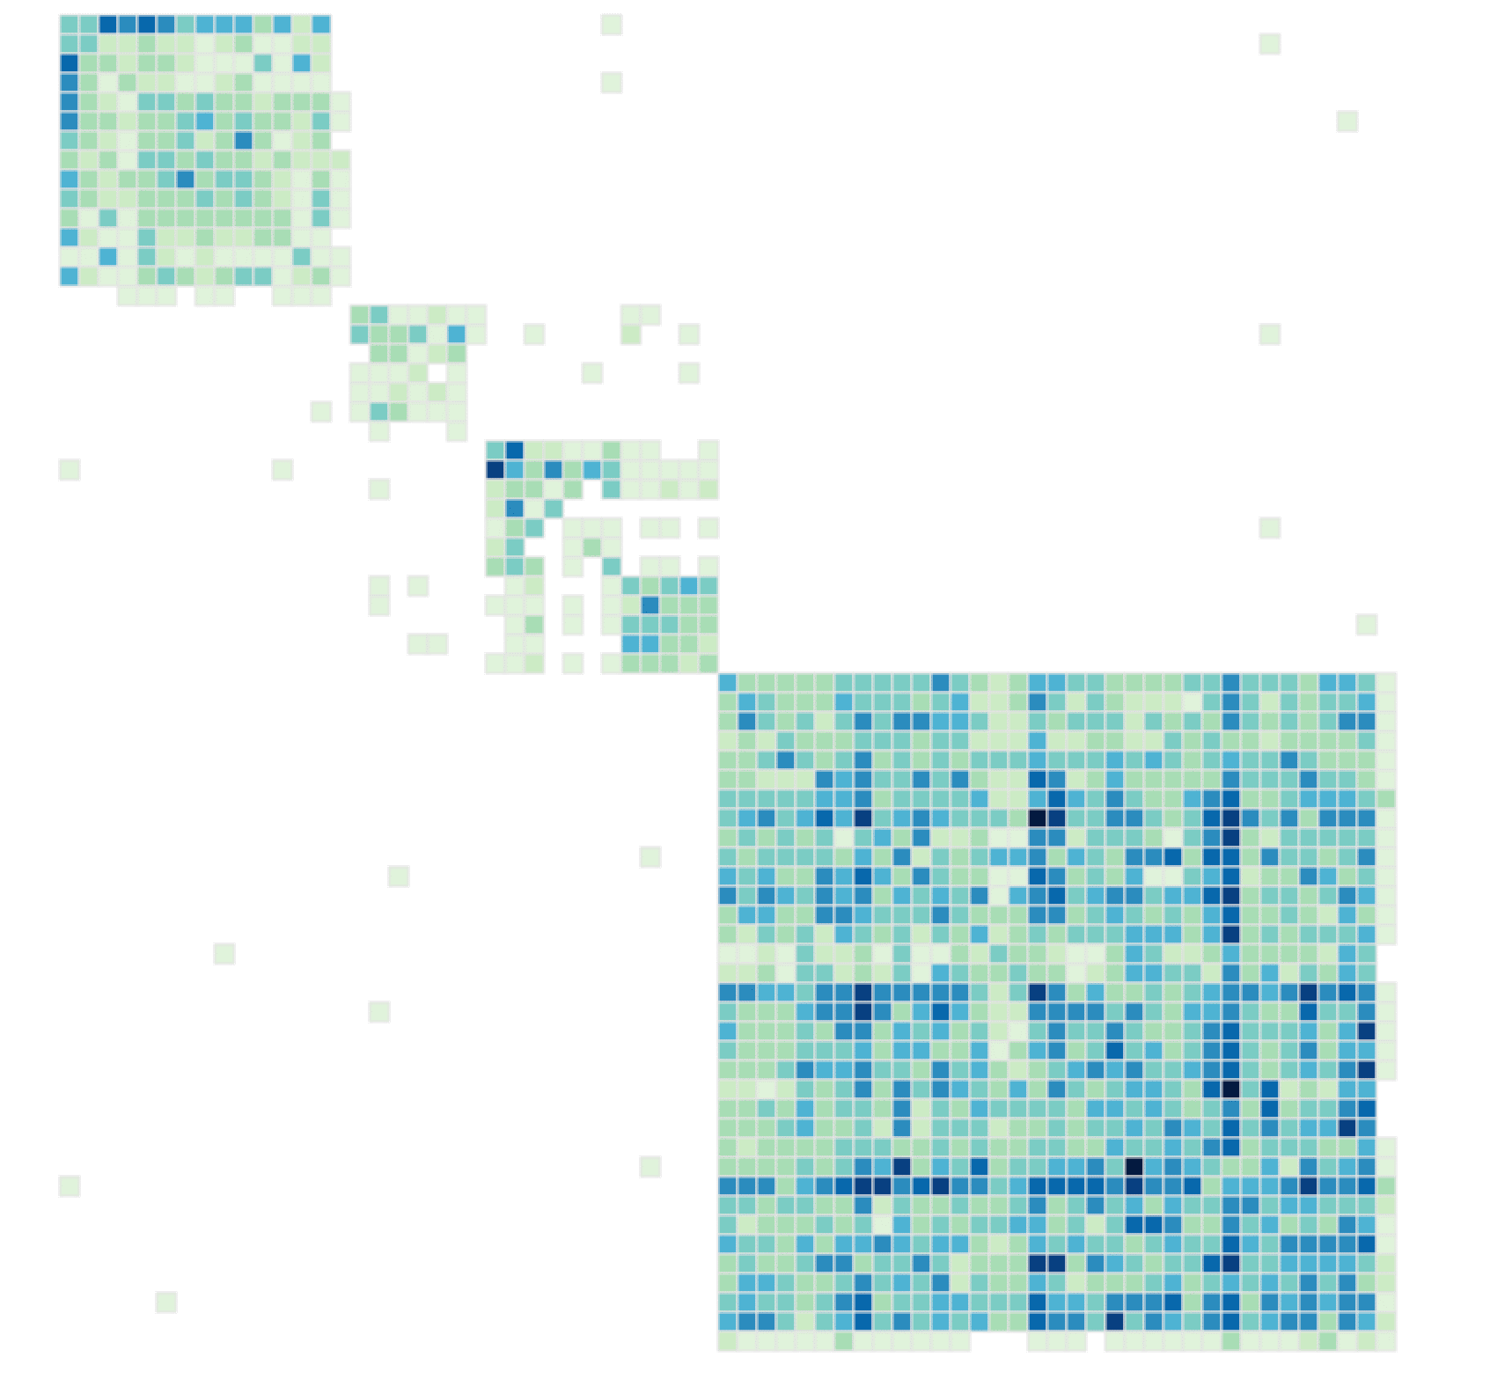
Notes:
Bay area bike share challenge – citizen-sourced analysis

Slide 15
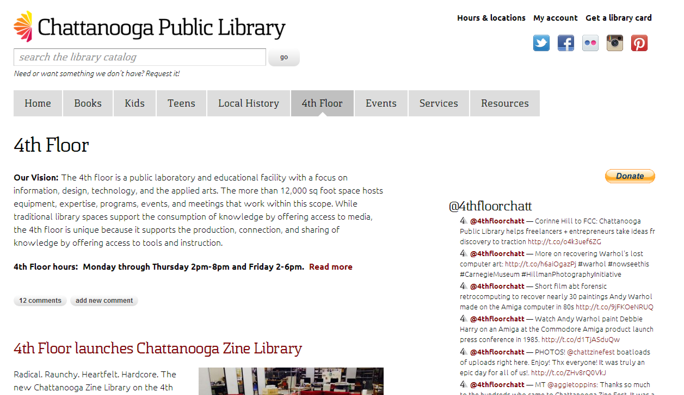
Notes:
Chatt lib: Bringing librarians back into the fold of data curation / discovery

Slide 16
Resources
https://data.oregon.gov/
http://civicapps.org/about/data-providers#D9
http://codeforamerica.org/brigade/
These slides available online: http://jden.us/cfp-frontier
Me: @_ jden or jden@codeforamerica.org

